Slide 1
Improving situation on the roads of Seattle
Suyash Prasad

Slide 2
Introduction
There are various means to travel on road be it vehicle, cycle or even pedestrians walking by it.
And for all this to be good utmost safety must be there for people traversing. So we need to decrease the probability of accident related to it.
With the given data we’re trying to predict the severity of injury so that betterment of physical conditions around the road can be done and proper immediate medical and other required support be provided quickly.

Slide 3
Data acquisition and cleaning
Dataset can be accessed through the link (https://s3.us.cloud-object-storage.appdomain.cloud/cf-courses-data/CognitiveClass/DP0701EN/version-2/Data-Collision.csv).
Dataset has 37 columns which needs to be filtered to get the relevant features only. So that our analysis can produce better results.
Rows with value “unmatched” in the status column has to be removed from the dataset.
And there are a lot of rows with missing values which has to be handled properly as per the columns.

Slide 4
Features for our analysis:
JUNCTIONTYPE
VEHCOUNT
PERSONCOUNT
COLLISIONTYPE
UNDERINFL
INATTENTION
SPEEDING

Slide 5
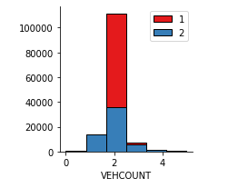
Affect of vehicle count
With the increase in number of vehicles chances of injury got higher with exception when the vehicle count was one.

Slide 6
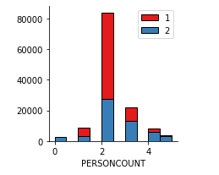
Affect of no. of people involved in the collision
Without any exception here with the increase in person count involved in collision chances of getting injured got increased.

Slide 7
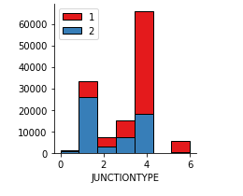
Different kind of junctions affecting the chances of injury
For the purpose of machine learning various junction types were converted into whole no. according to their alphabetical order. The tallest bar belongs to Mid-Block (not related to intersection) and the 2nd tallest belongs to At Intersection (intersection related) which also posses the maximum chances of injury.

Slide 8
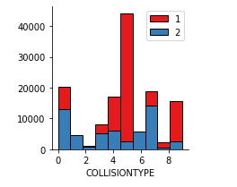
Collision involving pedestrian and cyclist are the worst
In this case also like the previous case different types of collision types are converted to whole number to make it useful for machine learning algorithm.

Slide 9
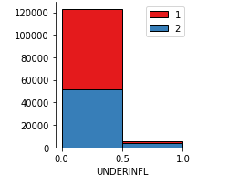
Best to have no influence of drugs or alcohol while driving
It’s quite good to follow some driving rules when you have driving wheel in your hand. It has been found in our dataset that being under influence of drugs or alcohol increases the chances of injury.

Slide 10
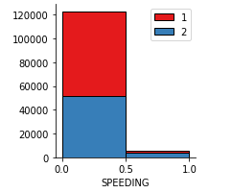
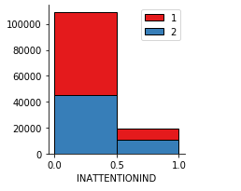
Show attention with speed limit while on the road
Always drive under the speed limit with
proper attention on road. Its good for
you and others travelling on the road.
As both speeding and inattention have
been proven to have severe affects on
the safety.

Slide 11
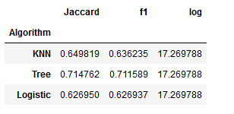
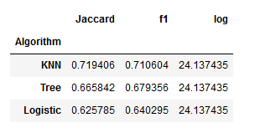
Predictive modelling
Training data accuracy Test data accuracy
Three machine learning algorithms were used for the classification purpose. Decision tree proved to have the best accuracy with the training data while K nearest neighbors was proven to the best for the test data. Logistic regression was at the bottom according to the accuracy on both the sets.

Slide 12
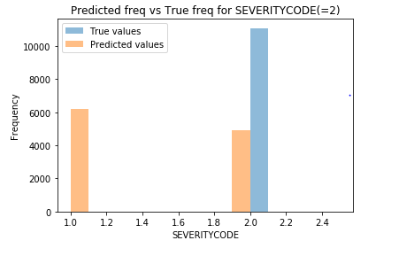
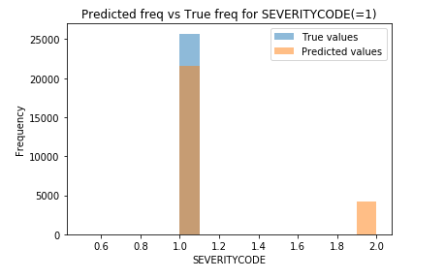
Conclusion
Getting the prediction of severitycode=1 correctly is very high but when severitycode=2 the chances of getting a correct result gets reduced.

Slide 13
Future scope
We can hope for better prediction of severitycode=2 with more data we collect on injury.
With some more specific data for some features we can get better accuracy.
Like by defining various ranges for speed of the vehicle. And by defining driver’s state when he/she is under the influence of some toxics.

